Slide 1

PROGRAMMING IN HASKELL
Topic 12.1 – Monads

Slide 2
Recap on functor
class Functor f where
fmap :: (a-> b) -> f a -> f b
fmap (+2) [1,2,3]
[3,4,5]
fmap (+2) (Just 1)
Just 2
fmap (+2) Nothing
Nothing

Slide 3
Recap on Applicative
Generalise the idea of Functors to functions with more than one argument or parameter
This gives rise to an Applicative Functor
class Functor f => Applicative where
pure :: a -> f a
( <*> ) :: f (a-> b) -> fa -> fb
Data structure of functions
Data structure of arguments
Data structure of results

Slide 4
Examples
pure (+) <*> Just 1 <*> Just 2
Just 3
pure (+) <*> Nothing <*> Just 2
Nothing
Applicative handles Errors (Nothing) correctly.

Slide 5
Introduce Monads – Example a simple evaluator
data Expr = Val Int | Div Expr
e.g.
e:: Expr
e = Div (Val 6) (Val 3)

Slide 6
eval :: Expr -> Maybe Int
eval (Val n) = n
eval (Div x y ) = eval x `div` eval y
Problem – how do we deal with division by zero (this would crash)

Slide 7
Need to refine program to deal with this
How to capture failure
safeDiv :: Int -> Int -> Maybe Int
safeDiv _ 0 = Nothing
safeDiv n m = Just (n `div` n)

Slide 8
Now, rewrite eval to use safeDiv
eval:: Expr -> Maybe Int
eval (Val n) = Just n
eval (Div x y) = case eval x of
Nothing -> Nothing
Just n -> case eval y of
Nothing -> Nothing
Just m -> safeDiv n m
Can we simplify?

Slide 9
Problem with Applicative
eval:: Expr -> Maybe Int
eval (Val n) = pure n
eval (Div x y) = pure safeDiv <*> eval x <*> eval y
Applicative needs Int -> Int -> Int
Maybe Int
Maybe Int
But we have Int -> Int -> Maybe Int

Slide 10
Monads – observe a common pattern and abstracting it out
eval:: Expr -> Maybe Int
eval (Val n) = Just n
eval (Div x y) = case eval x of
Nothing -> Nothing
Just n -> case eval y of
Nothing -> Nothing
Just m -> safeDiv n m

Slide 11
See pattern
Maybe (monadic) value
case of
Nothing -> Nothing
Just x ->
Some function on x

Slide 12
See pattern
case mx of
Nothing -> Nothing
Just x -> f x
We want to turn this into a definition.

Slide 13
See pattern
case mx of
Nothing -> Nothing
Just x -> f x
mx >>= f = case mx of
Nothing -> Nothing
Just x -> f x
We want to turn this into a definition.
“into” “bind”
(>>=) :: Maybe a -> (a-> Maybe b) -> Maybe b

Slide 14

>>=

Slide 15
New evaluation function using >>=
eval :: Expr -> Maybe Int
eval (Val n) = Just n
eval (Div x y) = eval x >>= (\n ->
eval y >>= (\m ->
safeDiv n m) )

Slide 16
General pattern
m₁ >>= \x₁ ->
m₂ >>= \x₂ ->
m₃ >>= \x₃ ->
:
:
m_{n} >>= \x_{n} ->
f x₁ x₂ .. x_{n}
“This is what we use”
do x₁ <- m₁
x₂ <- m₂
x₃ <- m₃
x_{n} <- m_{n}
f x₁ x₂ x₃ .. x_{n}
Syntactic sugar

Slide 17
New evaluation function using do (final version)
eval :: Expr -> Maybe Int
eval (Val n) = Just n
eval (Div x y) = do
n <- eval x
m <- eval y
safeDiv n m

Slide 18
So now we are ready for Monads
Now that we have bind (>>=) we now can define this kind of applicative that has bind.
class Applicative m => Monad m where
(>>= ) :: m a -> (a -> mb) -> mb
return :: a -> ma
return = pure

Slide 19
Example - Maybe – already have Functor, Applicative defs
data myMaybe a = Just a | Nothing deriving (Eq, Show)
instance Functor Maybe where
fmap f (Just x) = Just (f x)
fmap _ _ = Nothing
instance Applicative Maybe where
pure = Just
Nothing <*> _ = Nothing
(Just f ) <*> something. = fmap f something
instance Monad Maybe where
-- (>>=) :: Maybe a -> (a -> Maybe b ) -> Maybe b
Nothing >>= f = Nothing
Just x >>= f = fx

Slide 20
Example - Maybe – already have Functor, Applicative defs
data myMaybe a = Just a | Nothing deriving (Eq, Show)
instance Functor Maybe where
fmap f (Just x) = Just (f x)
fmap _ _ = Nothing
instance Applicative Maybe where
pure = Just
Nothing <*> _ = Nothing
(Just f ) <*> something. = fmap f something
instance Monad Maybe where
-- (>>=) :: Maybe a -> (a -> Maybe b ) -> Maybe b
Nothing >>= f = Nothing
Just x >>= f = fx

Slide 21
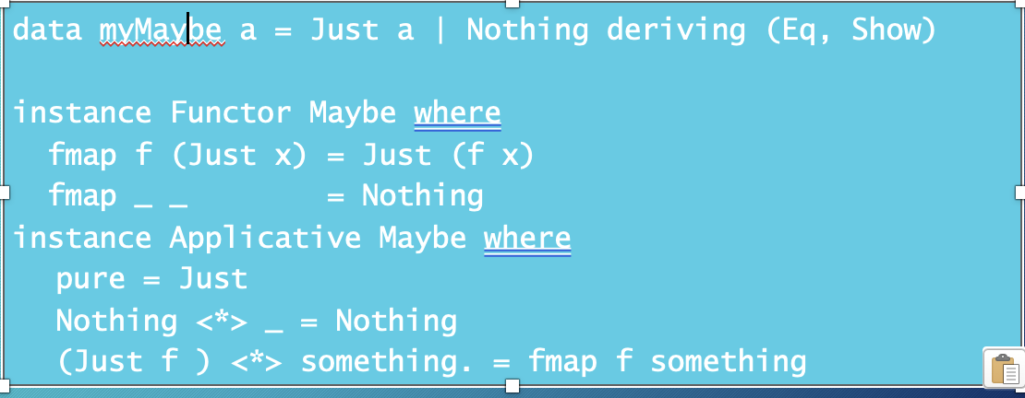
Example - Maybe – already have Functor, Applicative defs
instance Monad Maybe where
-- (>>=) :: Maybe a -> (a -> Maybe b) -> Maybe b)
Nothing >>= f = Nothing
Just f >>= f = f x
instance Monad Maybe where
-- (>>=) :: Maybe a -> (a -> Maybe b ) -> Maybe b
Nothing >>= f = Nothing
Just x >>= f = fx

Slide 22
Example - Lists
instance Monad [] where
-- (>>=) :: [a] -> (a -> [b] ) -> [b]
Nothing >>= f = Nothing
xs >>= f = concat map f xs
instance Monad [] where
-- (>>=) :: [a] -> (a -> [b] ) -> [b]
Nothing >>= f = Nothing
xs >>= f = [y| x <- xs, y <- f x]
or

Slide 23
Example - using List monads
pairs [1,2] [3,4] -- cartesian product
[(1,3), 1,4), (2,3), 2,4)
pairs :: [a] -> [b] -> [(a,b)]
pairs xs ys = do x <- xs
y <- ys
return (x,y)
or

Slide 24
Monad laws
Monads are required to obey 3 laws:
r >>= return = m
return x >>= f = f x
( m >>= f ) >>= g = m >>= (\x -> f x >>= g)
Monads originally come from a branch of mathematics called Category Theory.
(Fortunately, it is entirely unnecessary to understand category theory in order to understand and use monads in Haskell.)

Slide 25
Monadic Programming
Having designed a Monad (i.e. ‘I need a Monad with this shape), we define an instance of a Monad.
This involves essentially writing what
return and
>>= mean in this Monad

Slide 26
The IO Monad
Haskell is a pure language — functions have no side effects. The IO Monad is Haskell's controlled way of handling side effects like reading input, writing output, and file access.
-- IO is a type constructor:
newtype IO a -- a computation returning a value of type a
-- Common IO actions:
putStr :: String -> IO ()
putStrLn :: String -> IO ()
getLine :: IO String
readFile :: FilePath -> IO String

Slide 27
The Problem: Side Effects
Pure functions have no side effects — results depend only on inputs. The type IO a in a signature signals that a function interacts with the outside world.
-- This is pure — no IO:
double :: Int -> Int
double n = n * 2
-- This performs IO — the type says so:
greet :: String -> IO ()
greet name = putStrLn ("Hello, " ++ name)

Slide 28
IO as a Monad
IO is an instance of the Monad typeclass. The bind operator (>>=) sequences IO actions, passing the result of one action into the next.
instance Monad IO where
return :: a -> IO a
return x = ... -- wrap x in a do-nothing IO action
(>>=) :: IO a -> (a -> IO b) -> IO b
m >>= f = ... -- run m, pass result to f, run f

Slide 29
Sequencing IO with do
IO actions are sequenced with >>= (bind) or with do notation. The do block is syntactic sugar — each line binds the result of an IO action to a name.
-- Using >>= (bind):
getLine >>= \name ->
putStrLn ("Hello, " ++ name)
-- Using do notation (same thing):
do name <- getLine
putStrLn ("Hello, " ++ name)

Slide 30
A Complete IO Example
Every Haskell program starts at main :: IO (). It sequences IO actions to interact with the world.
main :: IO ()
main = do
putStrLn "What is your name?"
name <- getLine
putStrLn "How old are you?"
age <- getLine
putStrLn ("Hello " ++ name ++
", you are " ++ age ++ " years old!")

Slide 31
IO Monad – Key Points
The IO Monad makes side effects explicit in the type system. IO actions are first-class values — they can be stored, passed to functions, and combined freely.
-- IO actions are values — combine them freely:
askTwice :: IO (String, String)
askTwice = do
x <- getLine
y <- getLine
return (x, y)
-- return wraps a pure value in IO:
return :: a -> IO a
(>>=) :: IO a -> (a -> IO b) -> IO b

